Slide 1
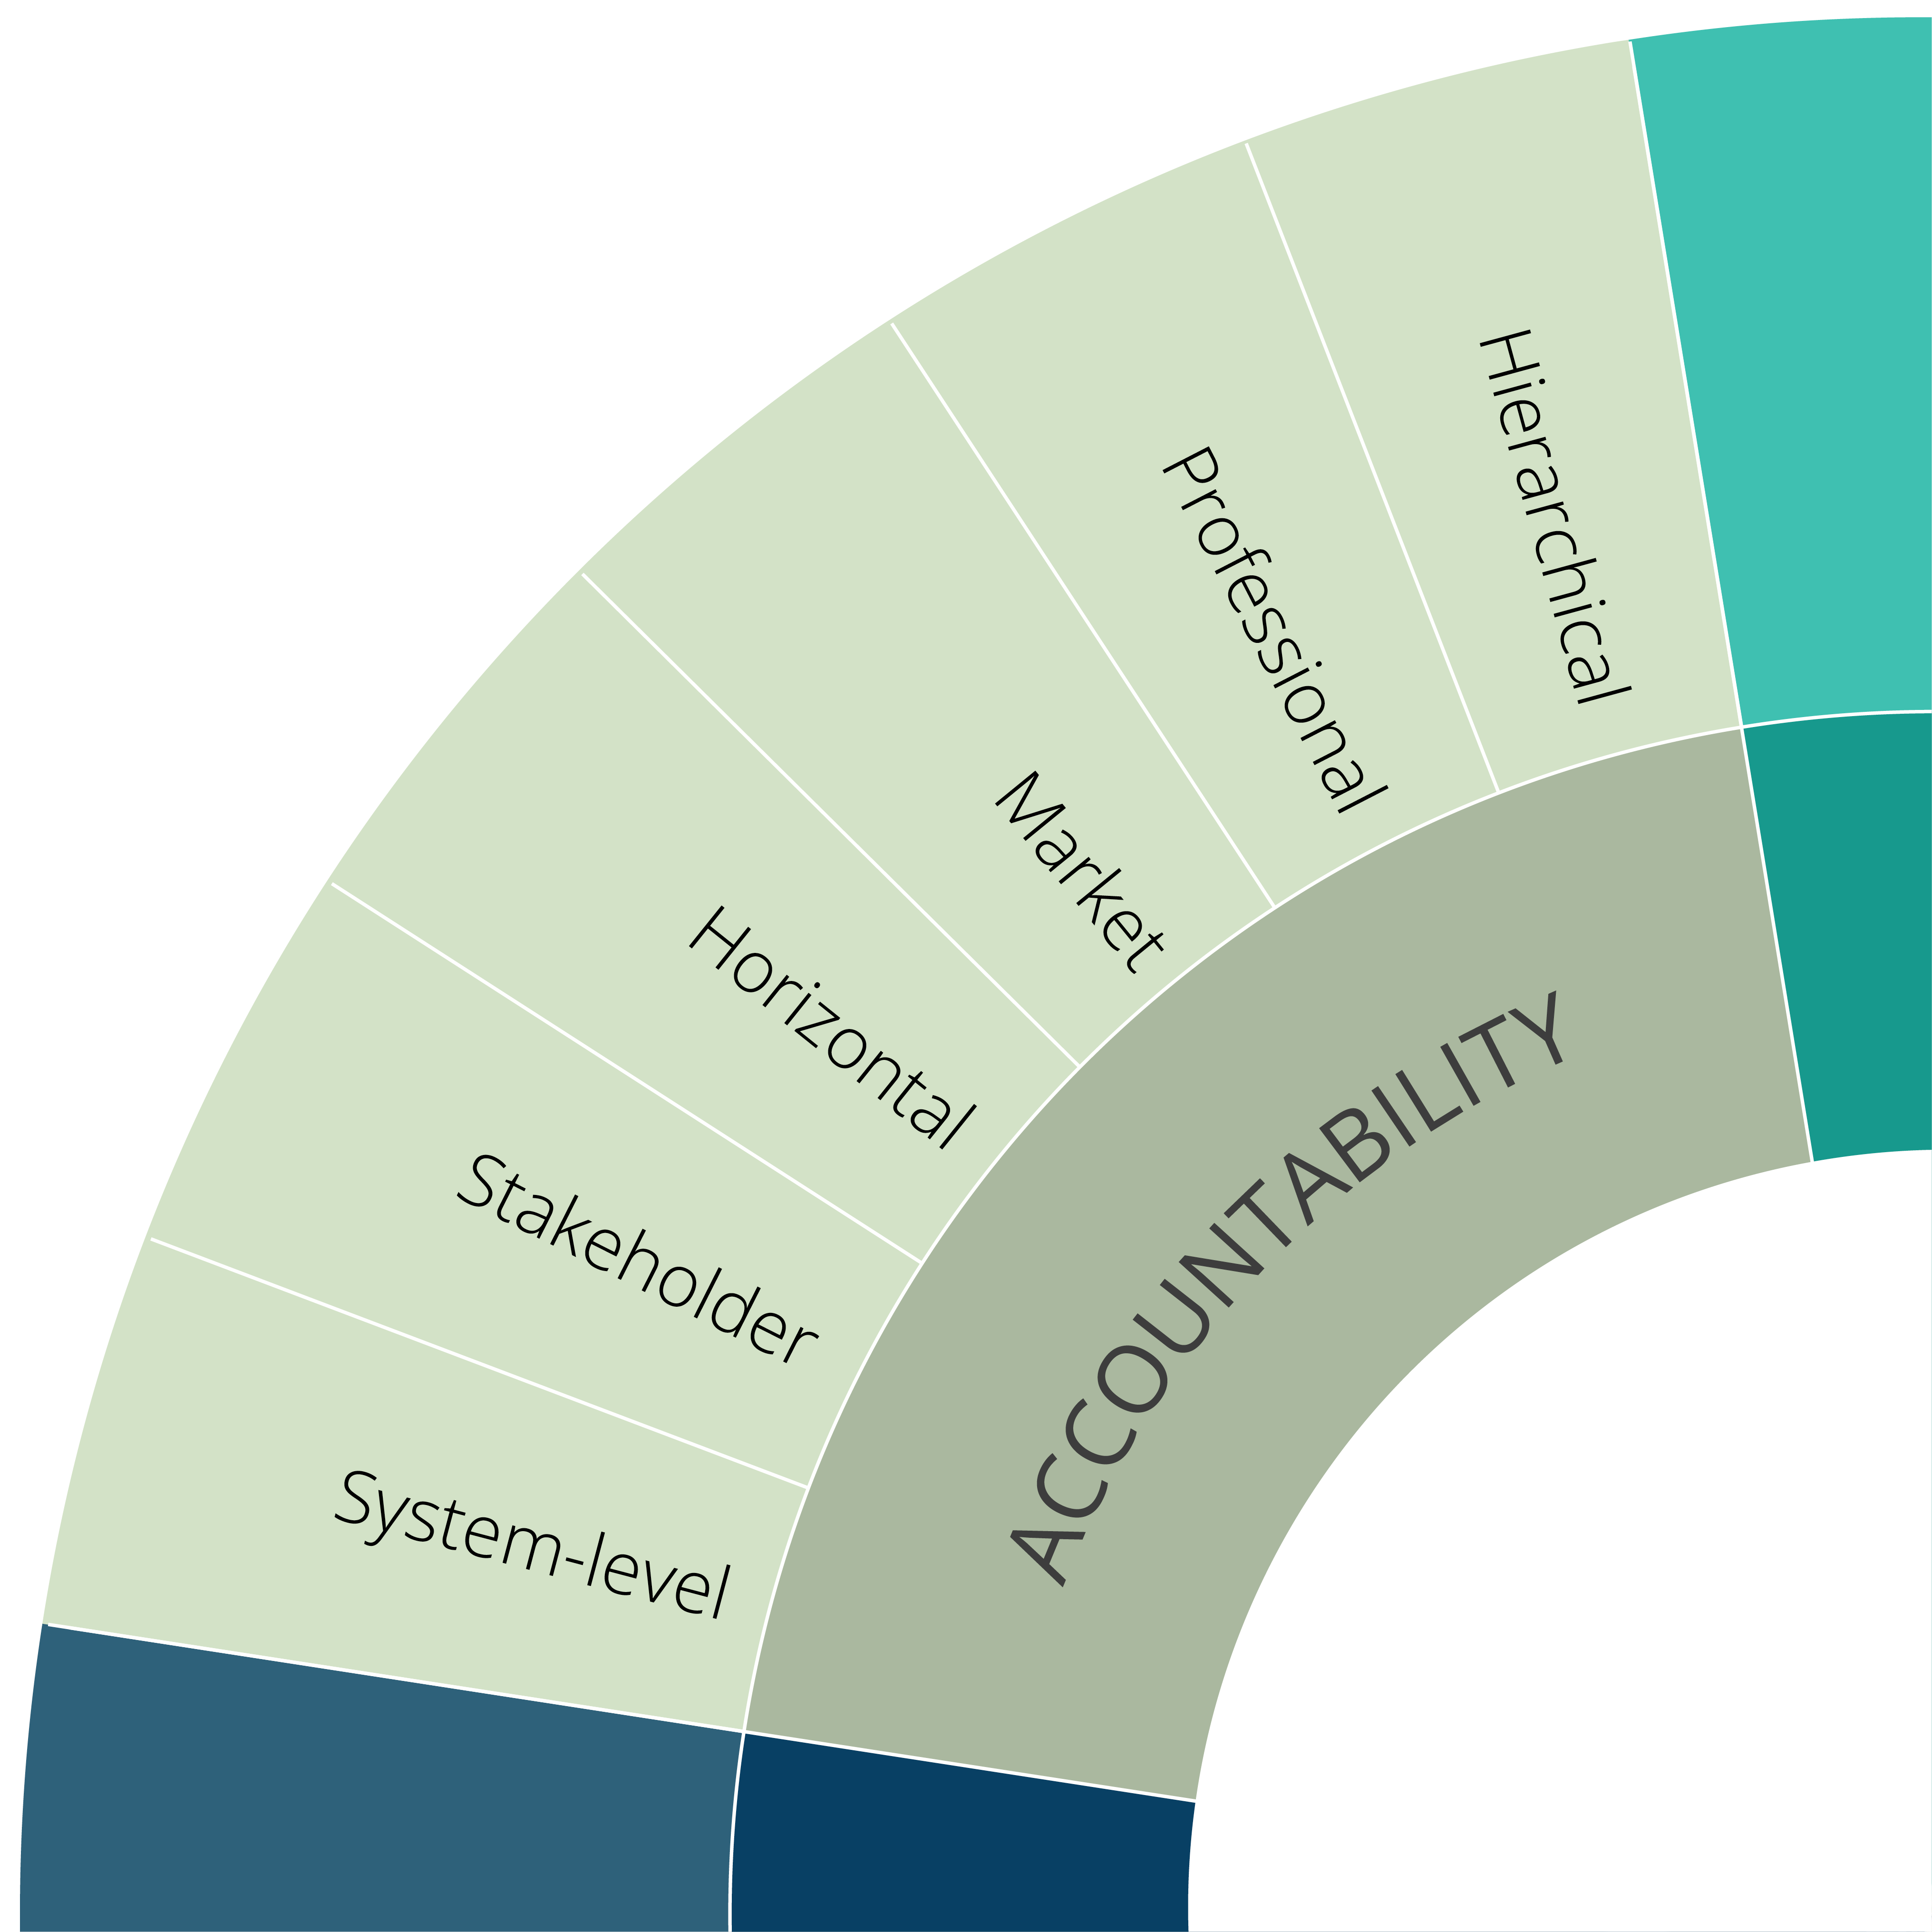
International Comparative Review
CES Comparative Reviews
Loic Menzies
Chief Research Officer – Centre for Education Systems
Senior Research Associate – Jesus College IF, Cambridge
lkm39@cam.ac.uk
1

Slide 2
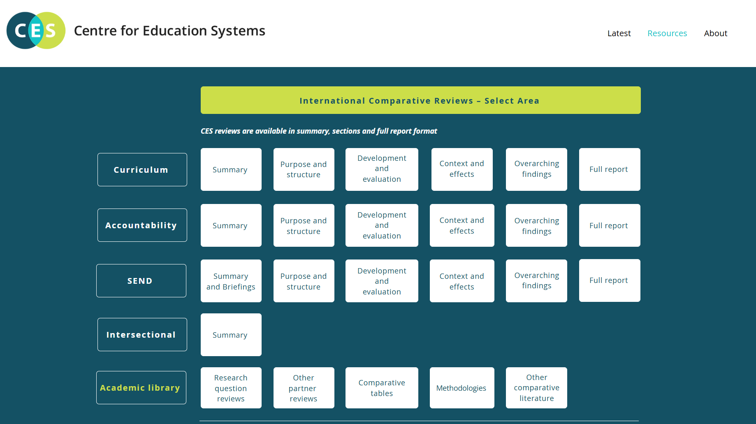

www.ces.partners >> resources

Slide 3
Four typical weaknesses in cross-jurisdictional policy learning
1. Country selection
2. Lack of sensitivity to purpose, context and process.
3. Interactions and ‘the coherence question’
4. ‘What works’ v. ‘what happens’

Slide 4
Which countries?

Slide 5
The risk
Picking winners: ‘High performing jurisdictions’
Shiny new things: Short-lived bubbles and lack of attention to trajectories
Selectivity to prove a point: Missing counter-examples

Slide 6
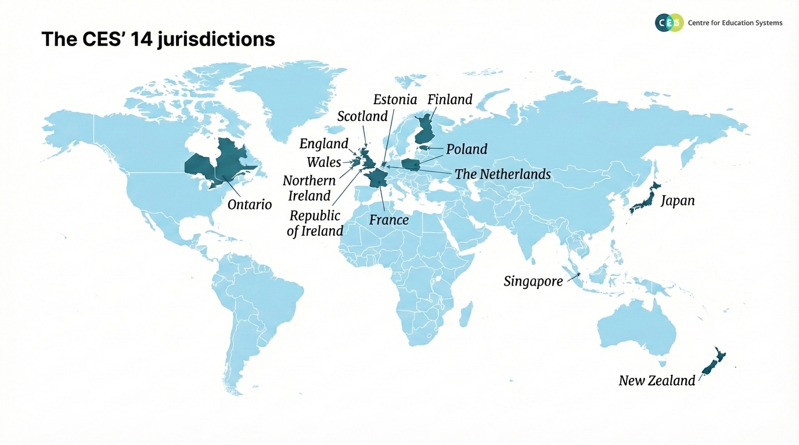

Slide 7
Country selection
Diversity within a similar domain¹:
High or upper-middle income
Near average/above-average educational performance in PISA – with mix of trajectories.
Variation in size/population (larger and smaller systems)
Democracies with a variety of political and cultural histories.
(+ Policy maker interest)
¹ Seawright & Gerring, 2008

Slide 8
Sensitivity to purpose, context and process

Slide 9
The risk
Countries are trying to achieve different things leading to different criteria for success.
Missing how a policy responds to and interacts with context.
Process is often a blind spot – but can influence success.

Slide 10
Research Questions
RQ1. What is the purpose of policy in this area (curriculum/accountability/special educational needs)?
RQ2. What is the structure of policy in this area?
RQ3: How is policy in this area made and introduced?
RQ4: How is accountability policy in this area evaluated?
RQ5: How does context shape policy and reform in this area?
RQ6: What is the evidence about the effects of the policy in this area?

Slide 11
ACCOUNTABILITY | Policies are generally designed to realise a combination of 6 core aims
Aim to promote | Definition (Accountability policies are designed to ..)
Equity & Inclusion | Promote fair access for all learners, regardless of background or ability (e.g Mandating anti-racism measures, support for special education needs etc.)
Wellbeing | Support the emotional, social, and physical welfare of students and staff (e.g Reporting on measures related to student engagement, mental health etc)
Cultural identity & affirmation | Reflect and protect customs and local identities (e.g Requiring instruction in national or minority languages)
Transparency | Enable decision making and promote public confidence by making results open and publicly available (e.g Publishing evaluation results for public access to stakeholders)
Compliance | Ensure consistency across schools by monitoring adherence to education laws and requirements (e.g Inspections assessing compliance with statutory requirements, with non-compliance potentially triggering sanctions)
Educational improvement/excellence | Drive improvements in teaching /learning outcomes (e.g Reporting on indicators related to academic attainment e.g. GCSE results)
Fairness and inclusion
Governance & Transparency
Outcomes & Performance

Slide 12



ACCOUNTABILITY | Context influences priorities and therefore policy design
History and culture
Resulting aims and priorities
Meritocracy
Outcomes & Performance
  Belief that success is – and should be determined by individual effort and performance, even if this involves unequal outcomes
  Strong societal interest in school performance and
  academic achievement
  Focus on measuring achievement and identifying ‘potential’.
  Professional accountability system (EPMS) used to enhance quality of educators: requires teachers to document targets and achievements, rewards and penalises based on performance
  Influences/linked to teachers’ strong sense of responsibility and pressure to maintain high standards
Singapore
Biculturalism
Equity and inclusion
  Key aspect of New Zealand identity, reflecting the partnership between Māori (Indigenous people) and NZ of European descent established under the Treaty of Waitangi
  Treaty principles underpin expectations that institutions recognise cultural difference, and promote equitable outcomes
  Aims centred on equity and inclusion
  Education Review Office (ERO) emphasises ensuring equitable outcomes for Māori learners and the evaluation of services which aim to lift Māori achievement
  ERO’s reviews are intended to support kura (schools) in valuing, affirming, and strengthening Māori identity, language, and culture
New Zealand
Post-Soviet nation-building
Civic development
  Post-Soviet independence has driven a strong emphasis on state-building, transparency, and clear institutional authority
  Education plays a central role in nation-building through the consolidation of Estonian as the language of instruction
  Accountability mechanisms reflect the goal of integrating Russian-speaking minorities while maintaining national standards
  Aims emphasise civic development and participation
  Focus on developing competencies that create added value to society align with national security and provide essential public services (e.g. teachers, health professionals, internal security staff, tech)
  New compliance requirements around teaching in Estonian
Estonia

Slide 13


ACCOUNTABILITY | Context influences policy effects
Context
Response to high stakes accountability
Marketised/choice-based system
Deeply embedded/institutionalised accountability
Hyper-compliance combined
Constructive resistance
Iterative change
England
Republican tradition
Weakly embedded/instutionalised accountability
Evasion
Dilution
France

Slide 14
SPECIAL EDUCATIONAL NEEDS | Policy design typically reflects choices across four dimensions
PHASED ROLLOUT
1
CENTRALISATION | WHO MAKES POLICY DECISIONS?
PAS | WHO ARE MAJOR CONTRIBUTORS TO POLICY?
STAKEHOLDER ENGAGEMENT
IMPLEMENTATION | HOW IS POLICY IMPLEMENTED?
2
3
4
ACADEMICS
CIVIL SERVANTS
Engagement with Representative bodies
Estonia & Poland
Singapore,
Japan, Ontario
Councils/Committees
FULL POLICY ROLLOUT
Decentralised
Parents
Ontario, Finland, Netherlands
Children
Stage 1
Stage 2
Stage 3
Hybrid
Scotland, Wales, Japan, France, New Zealand
Communities
Estonia & Poland
Ontario, Scotland
Centralised
England, Singapore, Northern Ireland, Ireland, Estonia, Poland
Direct engagement
Parents
Children
1 stage
NGOS/ADVOCACY GROUPS
Communities
Ontario
New Zealand, Ireland
New Zealand

Slide 15
Interactions between and within policies

Slide 16
The risk
Looking at a policy in isolation is out of step with how teachers and pupils experience policies.
Overlooking equifinality: same effect or function different policy/cause.
Ignoring coherence/incoherence.

Slide 17
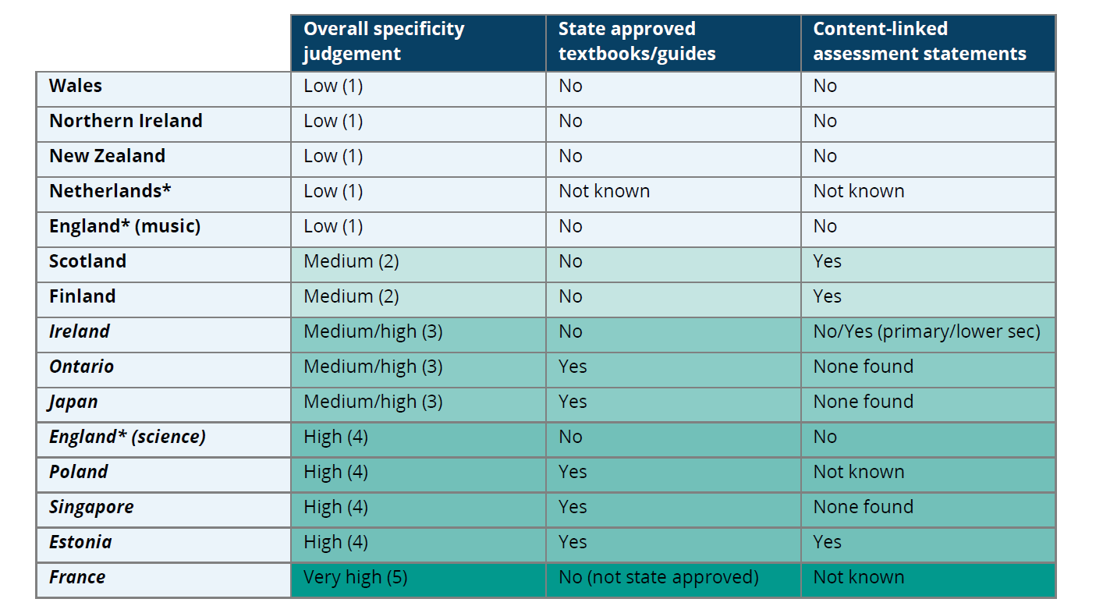
Curriculum policy | Policy interactions

Slide 18
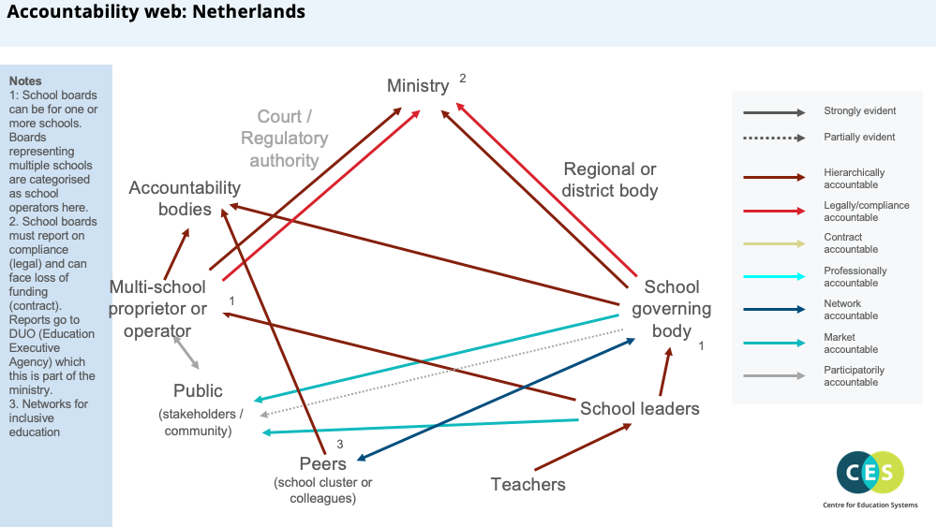

Slide 19
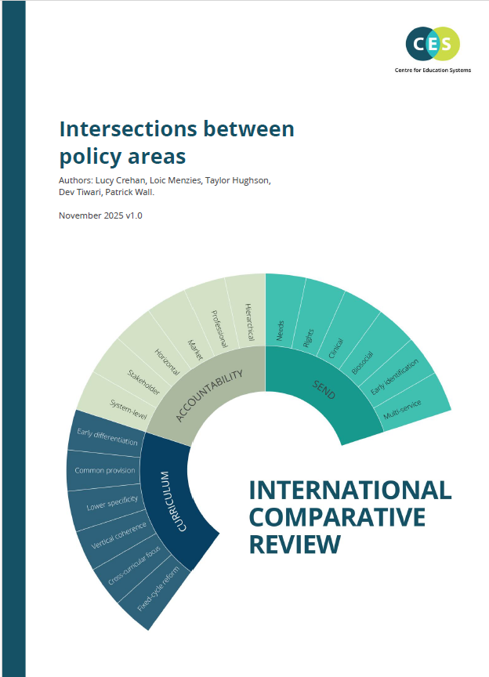
Tensions and complementarity
Building up layers of detail over time

Slide 20
‘What works’ v. ‘what happens’

Slide 21
The risk
Information gap: blindness to potential alternatives and dependencies
Jumping from correlation for causation
Making unreasoned choices

Slide 22


Alternative approaches to accountability |’Chain of command’
CONFIGURATION
FEATURES
Ministry
  Country examples (Non-exhaustive)
Court/
Regulatory authority
Estonia
Poland
Singapore
France
Japan
Regional or district body
  Examples show jurisdictions where configuration is most evident, systems typically combine multiple approaches
Quality
bodies
  Typical characteristics
  Most common form of accountability across 14 jurisdictions
  Systems with this approach often:
    Have more centralised system-governance
    Place less emphasis on school autonomy
    Focus more on compliance and direct support
Multi-school proprietor or operator
School board/
Governing body
School leaders
  Quality measures (Non-exhaustive)
Public
(stakeholders/
community)
  Inputs: Auditing financial reports, Teacher safeguarding records
  Processes: Classroom observations, Leadership evaluation
  Outcomes: Attainment results
Peers
(school cluster or colleagues)
Teachers
  Consequences (Non-exhaustive)
  Additional support or heightened oversight is preferred
  Sanctions also used (Rapid reinspection, warning letters, etc.)
Key
Active Participants
Accountability type
Legal
Hierarchical

Slide 23



Alternative approaches to accountability | ‘Polycentric accountability’
CONFIGURATION
FEATURES
Ministry
  Country examples (Non-exhaustive)
Court/
Regulatory authority
England
The Netherlands
Ontario
Quality
bodies
Regional or district body
  Examples show jurisdictions where configuration is most evident, systems typical combine multiple approaches
  Typical characteristics
  Often seen in systems with low centralisation (Ontario, Netherlands)
  Associated with New Public Management¹ (NPM) models which:
    Intended to encourage innovation and autonomy
    Introduces market-style mechanisms like performance targets, competition, and choice
Multi-school proprietor or operator
School board/
Governing body
School leaders
  Quality measures (Non-exhaustive)
Public
(stakeholders/
community)
  Inputs: Contract/regulatory compliance
  Process: Inspection grades
  Outcomes: Pupil attainment in standardised assessments
Peers
(school cluster or colleagues)
Teachers
  Consequences (Non-exhaustive)
Key
  Support provisions (from a school proprietor or operator, not the state)
  Contract based consequences e.g terminating funding or licences
Active Participants
Accountability type
Legal
Contractual
Hierarchical

Slide 24
Accountability:
Seven main intended ways of generating improvement…
Deterring malpractice:
  Requires clear expectations with a credible possibility of sanctioning.
  Primarily suited to ensuring compliance with minimum standards.
Prompting support that builds expertise and capacity:
  Requires school-improvement infrastructure + high quality input in right conditions.
Encouraging professional reflection and solution generation:
  Depends on high-trust environment with skilled professionals.
Driving pupils towards better performing schools:
  Depends on availability of alternatives
  Requires parents to make informed choices based on accurate/meaningful/accessible information.
  Risk of inequitable outcomes + struggling schools finding it harder to improve.
Prompting changes of management:
  Depends on availability of effective managers + conditions to lead effectively.
Directing additional effort and attention towards government priorities:
  Depends on incentives and pressures aligning with policy priorities.
  Professionals need capacity to direct towards priorities
  May mean other goals are neglected/innovation inhibited.
Creating system alignment and coherence:
  Requires shared priorities and professional learning across the system.
  Depends on professionals having opportunities and capacity to interact.

Slide 25
Curriculum | Key questions for policymakers
What is the best way to achieve the appropriate amount of content in each subject?
How can the curriculum build in sufficient flexibility to support teacher autonomy?
What are the purposes of this curriculum, and how should they be expressed?
How can this curriculum support student progress over time, and address different rates of progress between different pupils?
How can the curriculum provide sufficient specificity to support clarity, progression and equality?
At what age should student choice or selection be prioritised over a common curriculum?
Who should oversee curriculum reform, and how should wider involvement and consultation be managed?
How will the implementation of the curriculum framework allow teachers the time, resources and support to make a success of it?
Should the amount of time spent per subject be centrally mandated?
How can this curriculum support links across subjects, and broader skills, without confusing or overwhelming teachers?
Source:

Slide 26




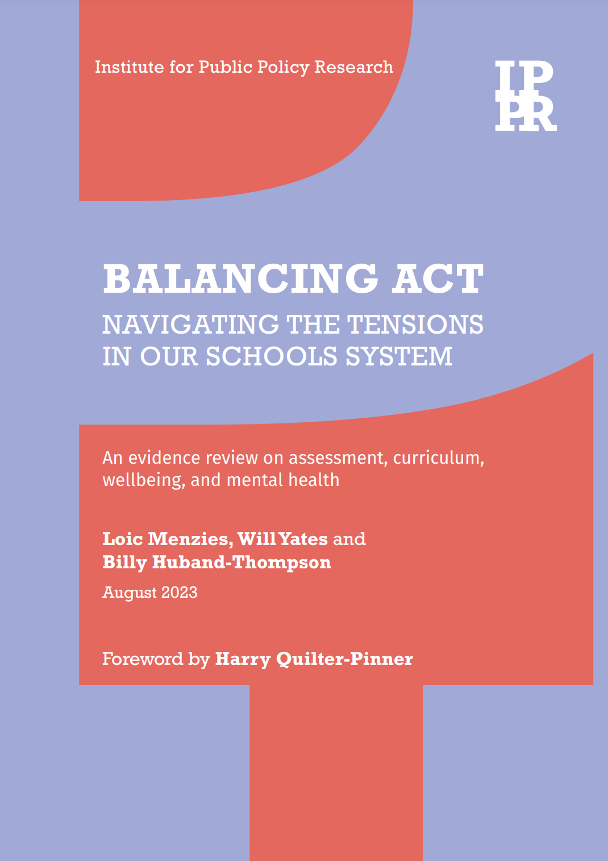
All CES reports (including curriculum, accountability, special educational needs + intersections) available at: www.ces.partners
Loic Menzies
Chief Research Officer - Centre for Education Systems
loic.Menzies@gmail.com

